Slide 1

Project Title -
Student Name – Aditya Raj
College Name- Trident Academy Of Technology
Internship ID: INTERNSHIP_17830691666a4779eecfe8a
STU ID: :STU6801129018d5c1744900752

Slide 2

PROBLEM STATEMENT
Agricultural activities are influenced by seasonal variations in environmental conditions, farming practices, resource availability and market conditions. As a result, agricultural performance may differ from one season to another.
However, raw agricultural data does not clearly explain how agricultural performance changes across seasons or what patterns can be observed in different seasonal conditions.
The problem is to analyze the given agricultural dataset and investigate seasonal differences in agricultural performance by identifying meaningful patterns, trends, relationships and variations within the available data.

Slide 3
Project Description :- This project analyzes agricultural data across different seasons, crops, regions, environmental conditions, farming practices, resource usage, and economic factors. The analysis uses Python, Pandas, NumPy, Matplotlib, Seaborn, and SciPy to clean and explore the dataset, identify seasonal patterns, compare agricultural performance, analyze relationships between variables, detect unusual observations, and evaluate yield, production, profitability, water efficiency, and disease/pest risk. The project also performs statistical analysis and comparative analysis across states, districts, crops, irrigation methods, seed quality, and seasons. The final findings are used to develop evidence-based recommendations for better crop selection, resource management, risk reduction, and agricultural planning.

Slide 4

WHO ARE THE END USERS?
Farmers and agricultural practitioners
Agricultural planners and analysts
Researchers and students
Government and agricultural support organizations
Decision-makers interested in seasonal agricultural performance

Slide 5

Technology Used
Python
Jupyter Notebook
Pandas – data cleaning and analysis
NumPy – numerical operations
Matplotlib / Seaborn – visualization
Scikit-learn / SciPy – statistical or analytical techniques where appropriate

Slide 6
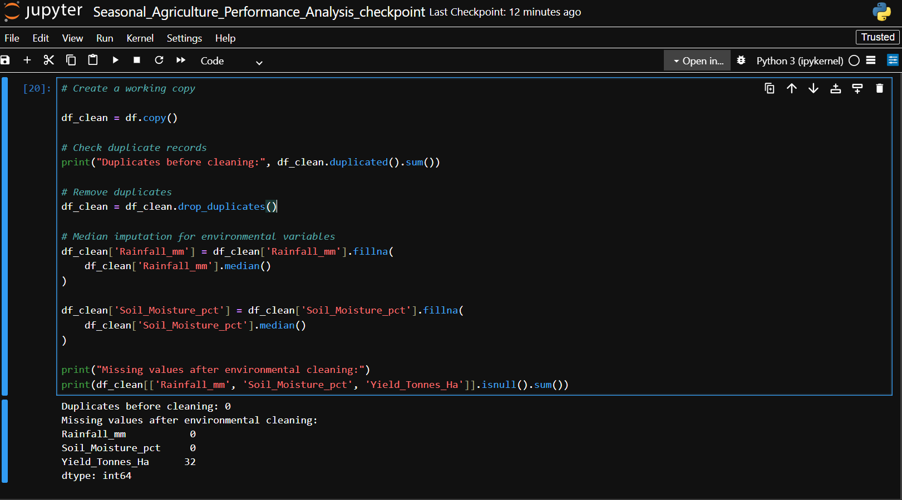
RESULT 1 — DATA QUALITY & PREPARATION
4,000 records and 28 columns were analyzed.
48 missing Rainfall values (1.20%), 40 Soil Moisture values (1.00%) and 32 Yield values (0.80%).
No duplicate records were detected.
Missing numerical values were handled during the cleaning stage before analysis.

Slide 7
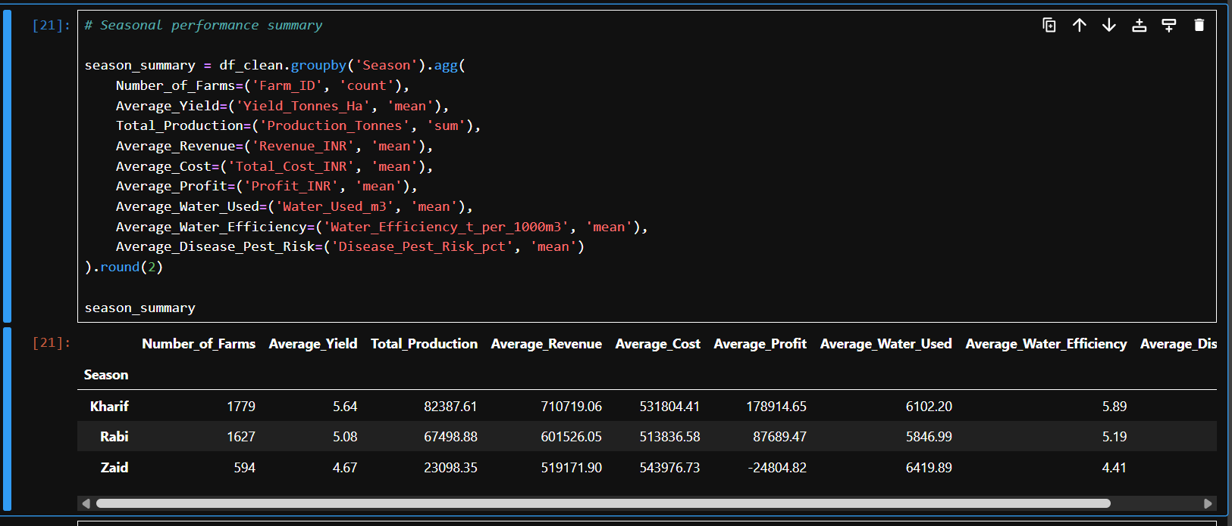
RESULT 2 — SEASONAL PERFORMANCE
Kharif: average yield 5.64 t/ha; average profit ₹178,914.65; water efficiency 5.89 t/1,000 m³; risk 54.47%.
Rabi: average yield 5.08 t/ha; average profit ₹87,689.47; water efficiency 5.19; risk 40.48%.
Zaid: average yield 4.67 t/ha; average profit −₹24,804.82; water efficiency 4.41; risk 38.22%.
Kharif leads on average yield, profit and water efficiency; Zaid has the lowest average profit

Slide 8
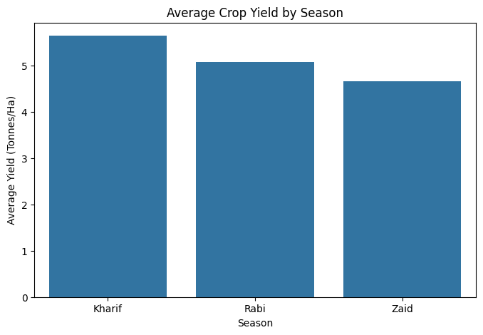
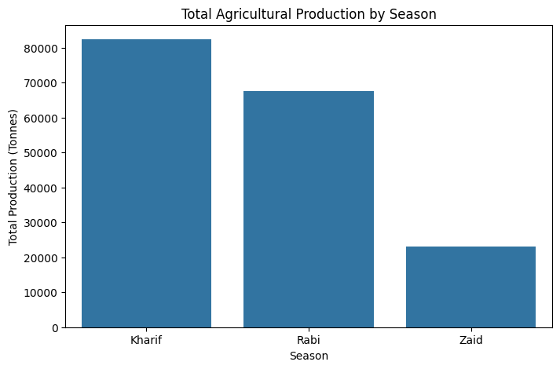
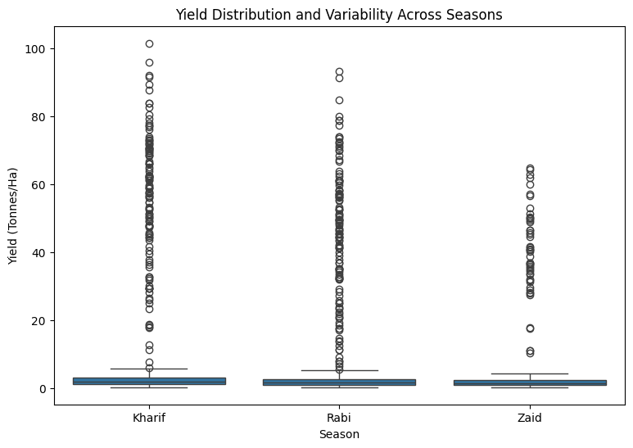
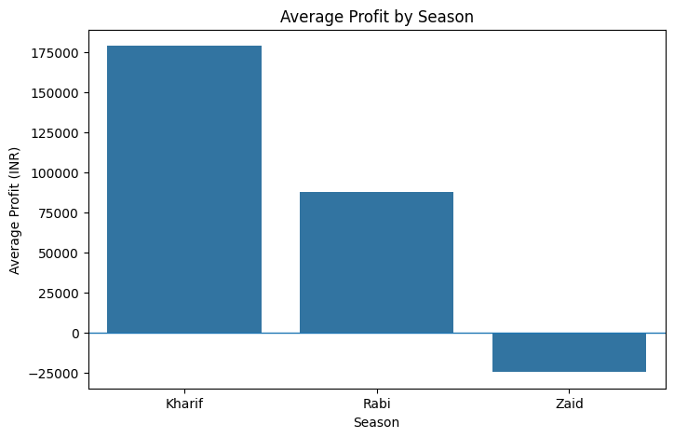
SEASONAL PERFORMANCE: VISUAL ANALYSIS

Slide 9
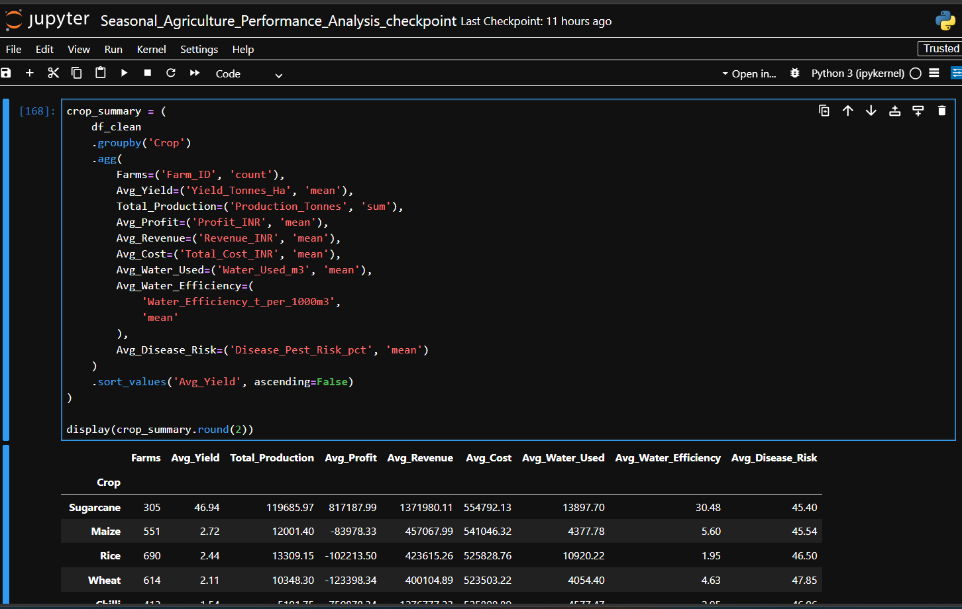
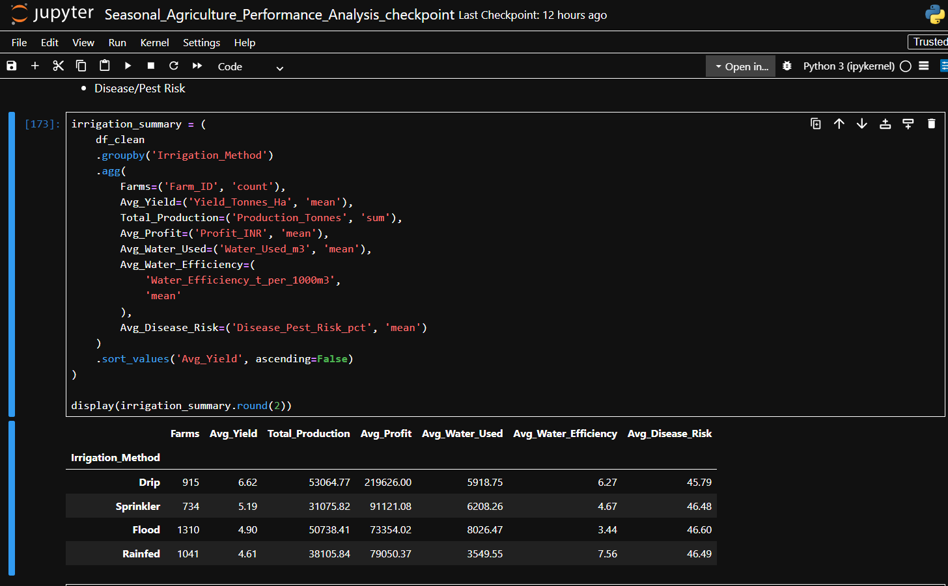
RESULT 3 — CROP & IRRIGATION INSIGHTS
Sugarcane is the best crop by average yield and also the best crop by average profit.
Drip irrigation gives the highest average yield among irrigation methods.
Rainfed farming has the highest average water efficiency in the analysis.
Performance differs by crop × season, so overall crop averages alone are not sufficient.

Slide 10
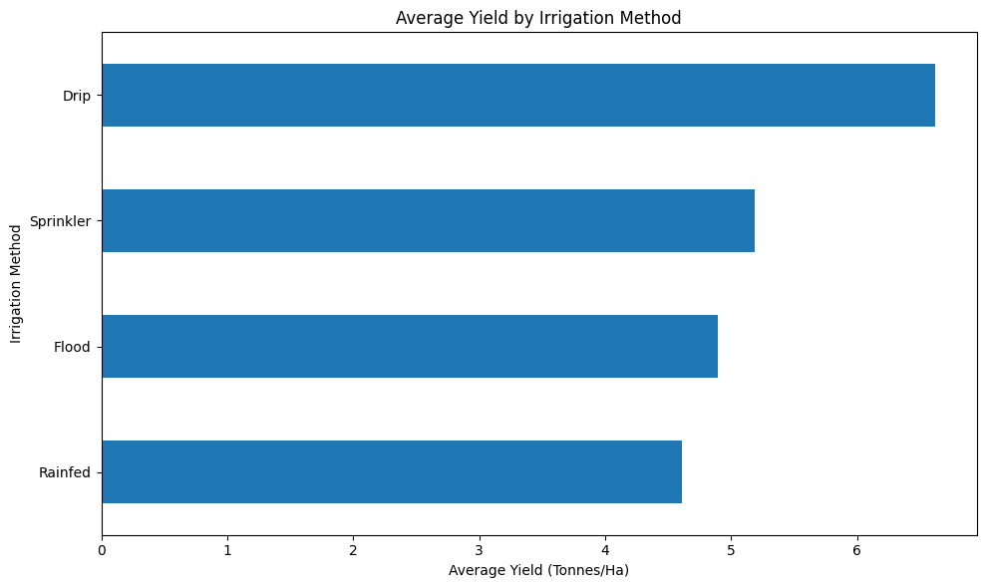
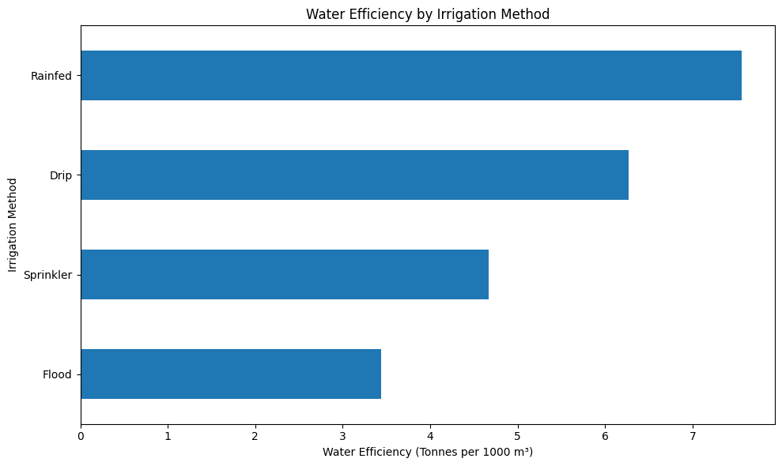
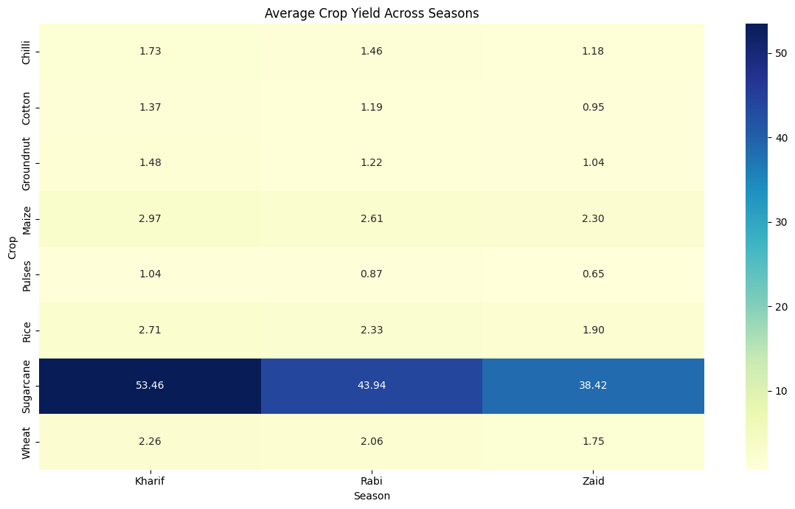
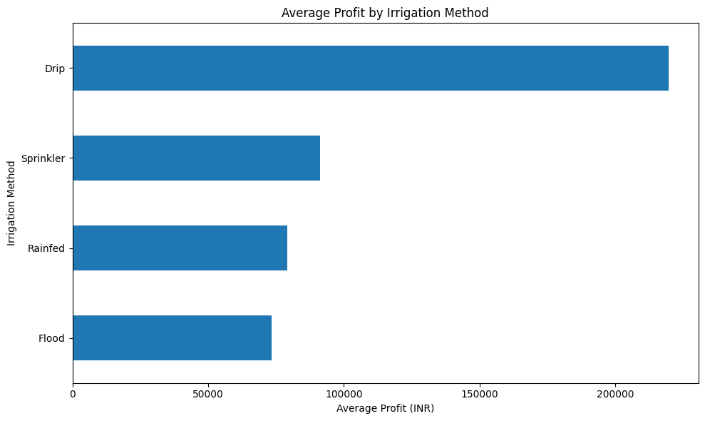
Average Profit by Irrigation Method

Slide 11
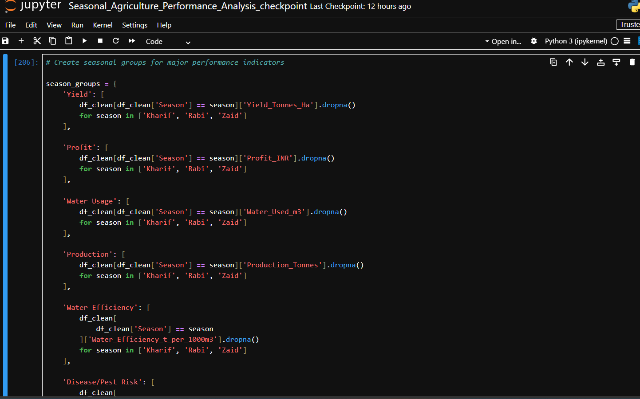
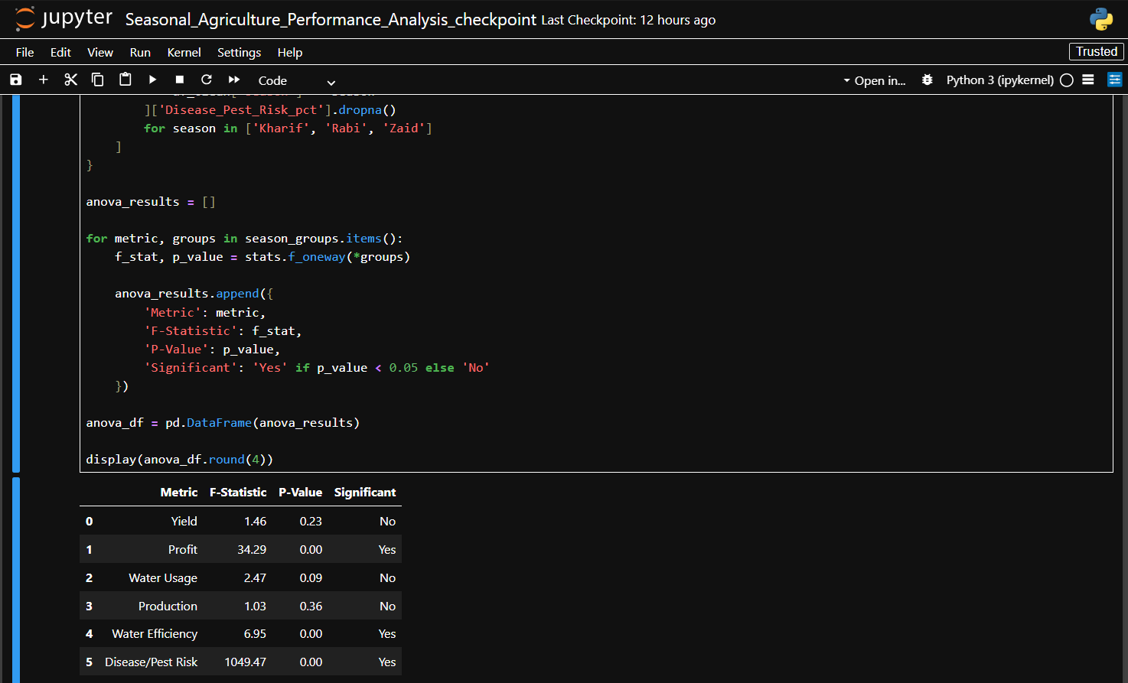
RESULT 4 — VARIABILITY & STATISTICAL EVIDENCE
Yield coefficient of variation: Kharif 255.48%, Rabi 252.44%, Zaid 242.56%.
Zaid is the most consistent season by yield CV; Kharif is the most variable.
ANOVA and post-hoc testing were used to assess whether seasonal differences are statistically meaningful.
Correlation analysis found weak overall relationships between environmental variables and yield in this dataset.

Slide 12
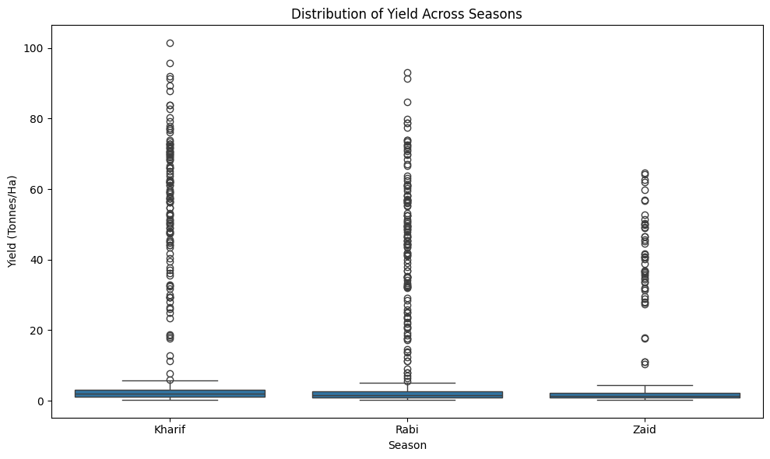
Distribution of Yield Across Seasons

Slide 13
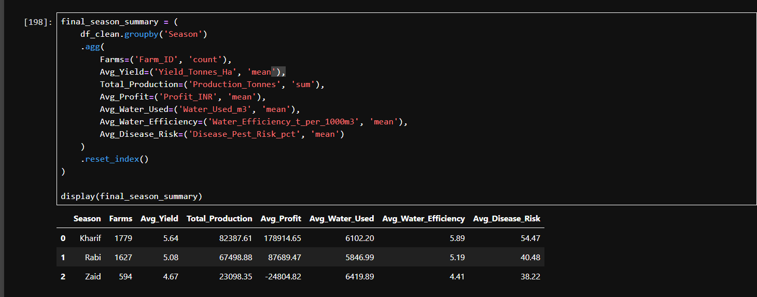
RESULT 5 — MULTI-FACTOR PERFORMANCE
Overall score weights: 30% Yield + 30% Profit + 20% Water Efficiency + 20% Risk.
Top crop-season combination: Sugarcane – Kharif, with overall performance score 0.82.
Sugarcane – Rabi follows with score 0.80; Sugarcane – Zaid scores 0.72.
The score is an analytical comparison, not a universal agricultural standard.

Slide 14
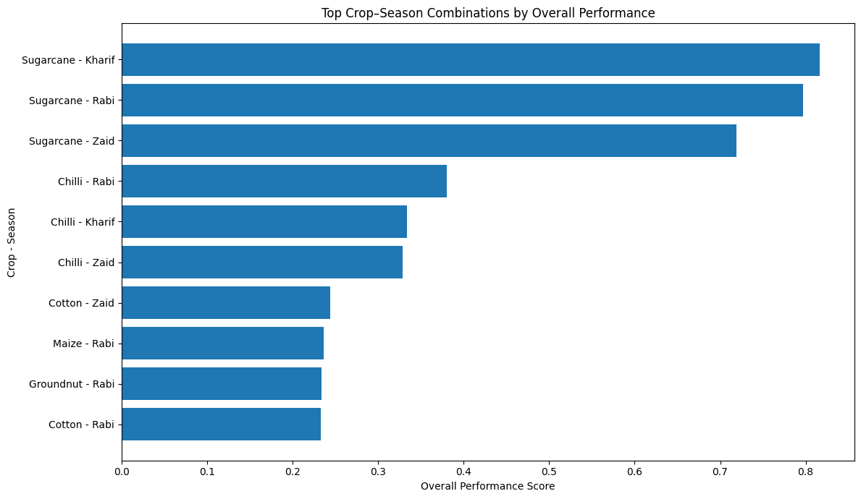

Slide 15
Future scope
Machine Learning: Develop models to predict crop yield and profitability.
Smart Crop Recommendation: Recommend suitable crops based on season, soil, weather, and resources.
Real-Time Weather Data: Integrate live rainfall, temperature, humidity, and weather forecasts.
Resource Optimization: Optimize water, fertilizer, and pesticide usage.
Disease & Pest Prediction: Build early-warning systems for agricultural risks.
Interactive Dashboard: Develop a Power BI/Tableau dashboard for real-time decision-making.
Satellite & IoT Integration: Use satellite imagery and IoT sensors for field-level monitoring.
Larger Dataset: Include multiple years and more geographical regions for more reliable predictions.

Slide 16
GitHub Link
Adityaraj042003/Seasonal-Agriculture-Performance-Analysis: An end-to-end data analytics project that analyzes agricultural performance across Kharif, Rabi, and Zaid seasons using environmental conditions, farming practices, resource utilization, crop performance, and economic indicators.

Slide 17
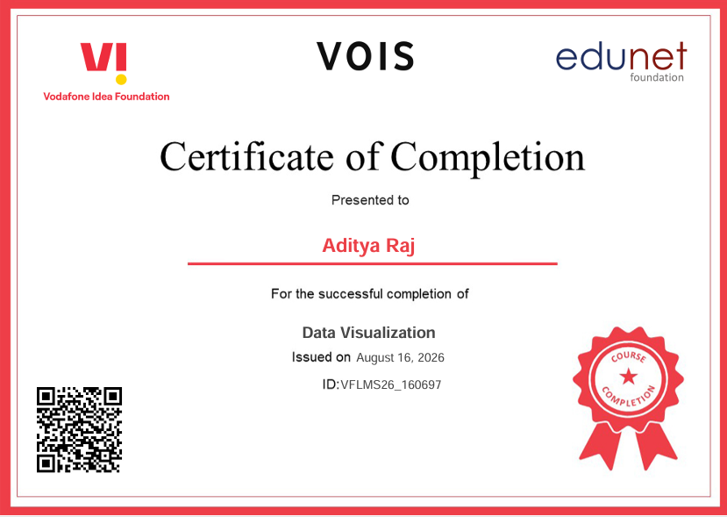
VOIS Course completion certificate - Course name- Data Visualization

Slide 18
Thank you
.
.

